Slide 1

DATA ANOMALIES DETECTION
BUSINESS ANALYTICS PROJECT 1

Slide 2

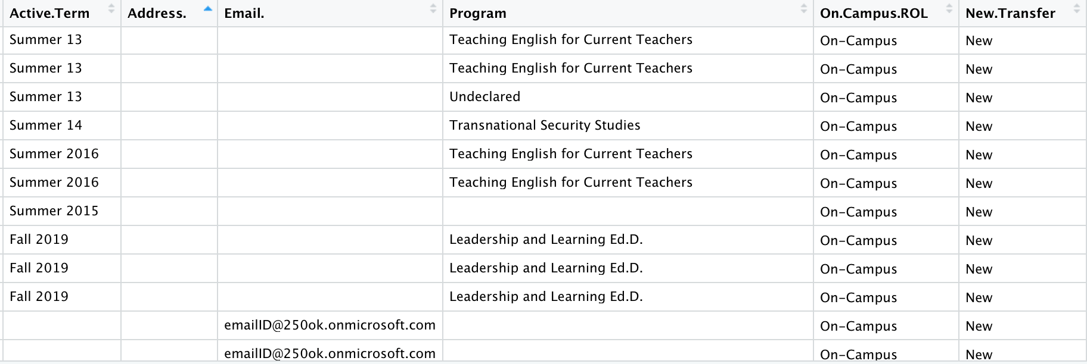
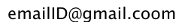
How do you feel in this data set?
Data Completeness
Data Consistency
Data Accuracy

Slide 3
Presentation Timeline
Dashboard of Data Quality Analysis
Data Completeness Data Accuracy
Data Consistency
Best way to market / recruit student with incomplete data
What is the problem?
2
4
1
3
5
Select the Data Schema Prospect Student Applicant Student Admitted Student
Recommendation for managing anomalies

Slide 4
Data Schema
Prospect
Student
Applicant
Student
Admitted
Student
Prospect Student
Applicant Student
Admitted Student
Population
Email
Active Term
Program
Source
Address Country
Address State
College State
College Name
High School Country
Population
Email
Active Term
Program
Program Type
Address Country
Citizenship Country
College Country
College GPA
High School Country
High School GPA
Population
Email
Active Term
Program
Address
Citizenship Country
VISA Required

Slide 5
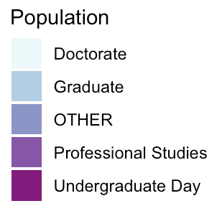
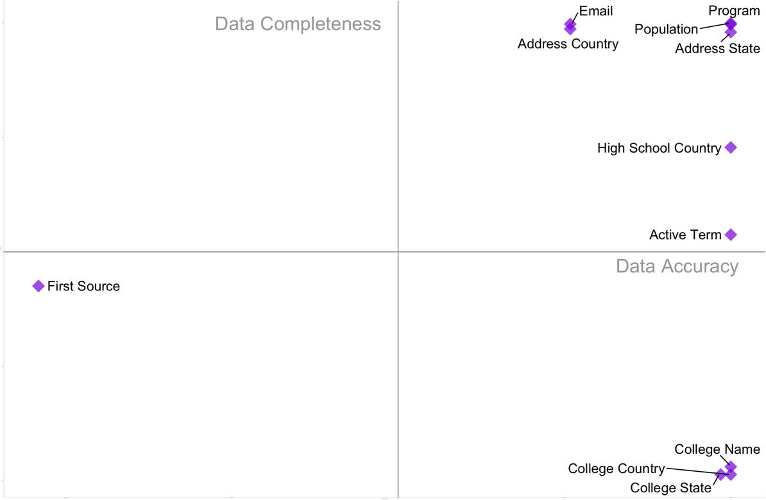
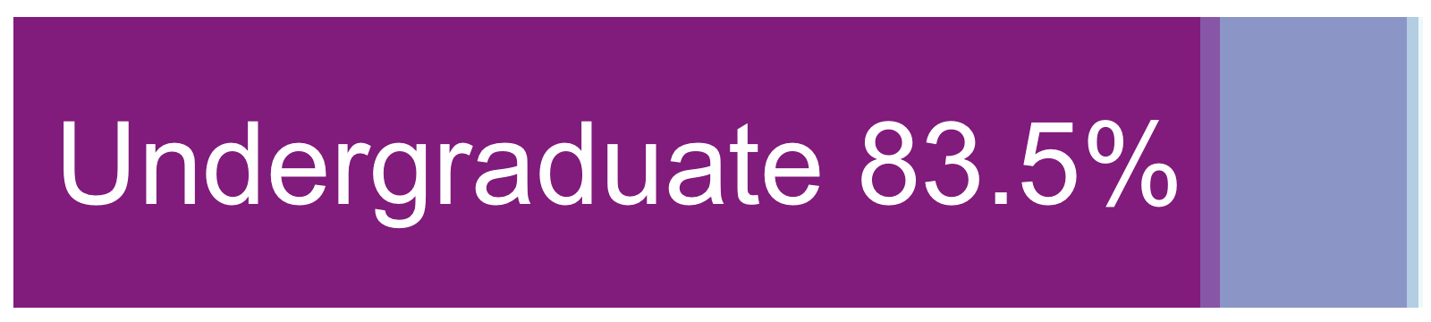
Data Quality of Prospect Student
Data Completeness
Data Distribution of student with null college information
Data Completeness vs Data Accuracy
2
1
Data Accuracy
Common First Source Anomalies:
2268
2323
3570
3828
3829
4465
3
4

Slide 6

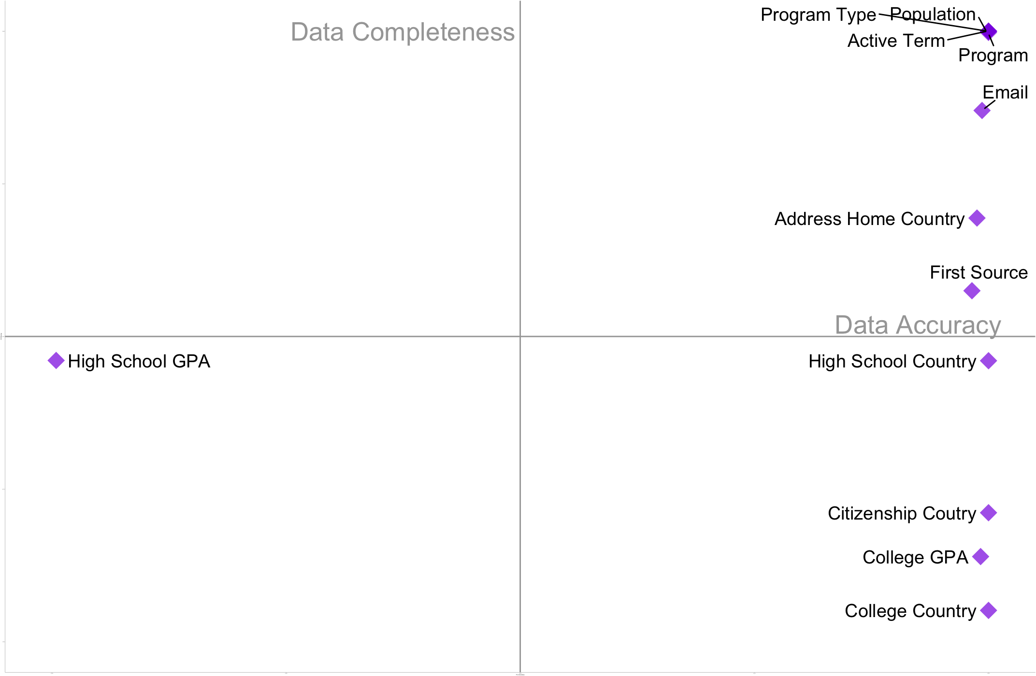
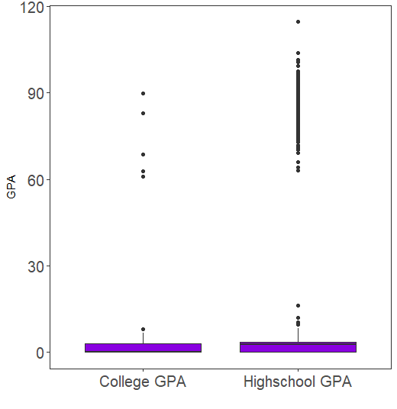
Data Quality of Applicant Student
Data Completeness
Data Distribution of student with null college information
Data Completeness vs Data Accuracy
2
1
axis.text.x =
Data Accuracy
3
4

Slide 7
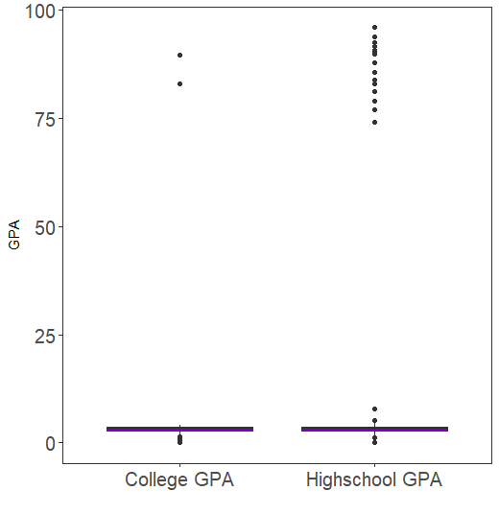
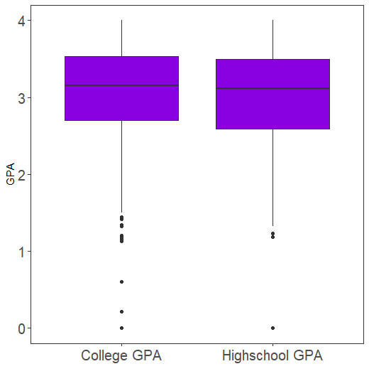
Data Consistency of Numeric Variables
All Region
United States
1st quartile | 0.00 | 0.00
3rd quartile | 3.04 | 4.30
1st quartile | 2.70 | 2.69
3rd quartile | 3.15 | 3.63
7

Slide 8
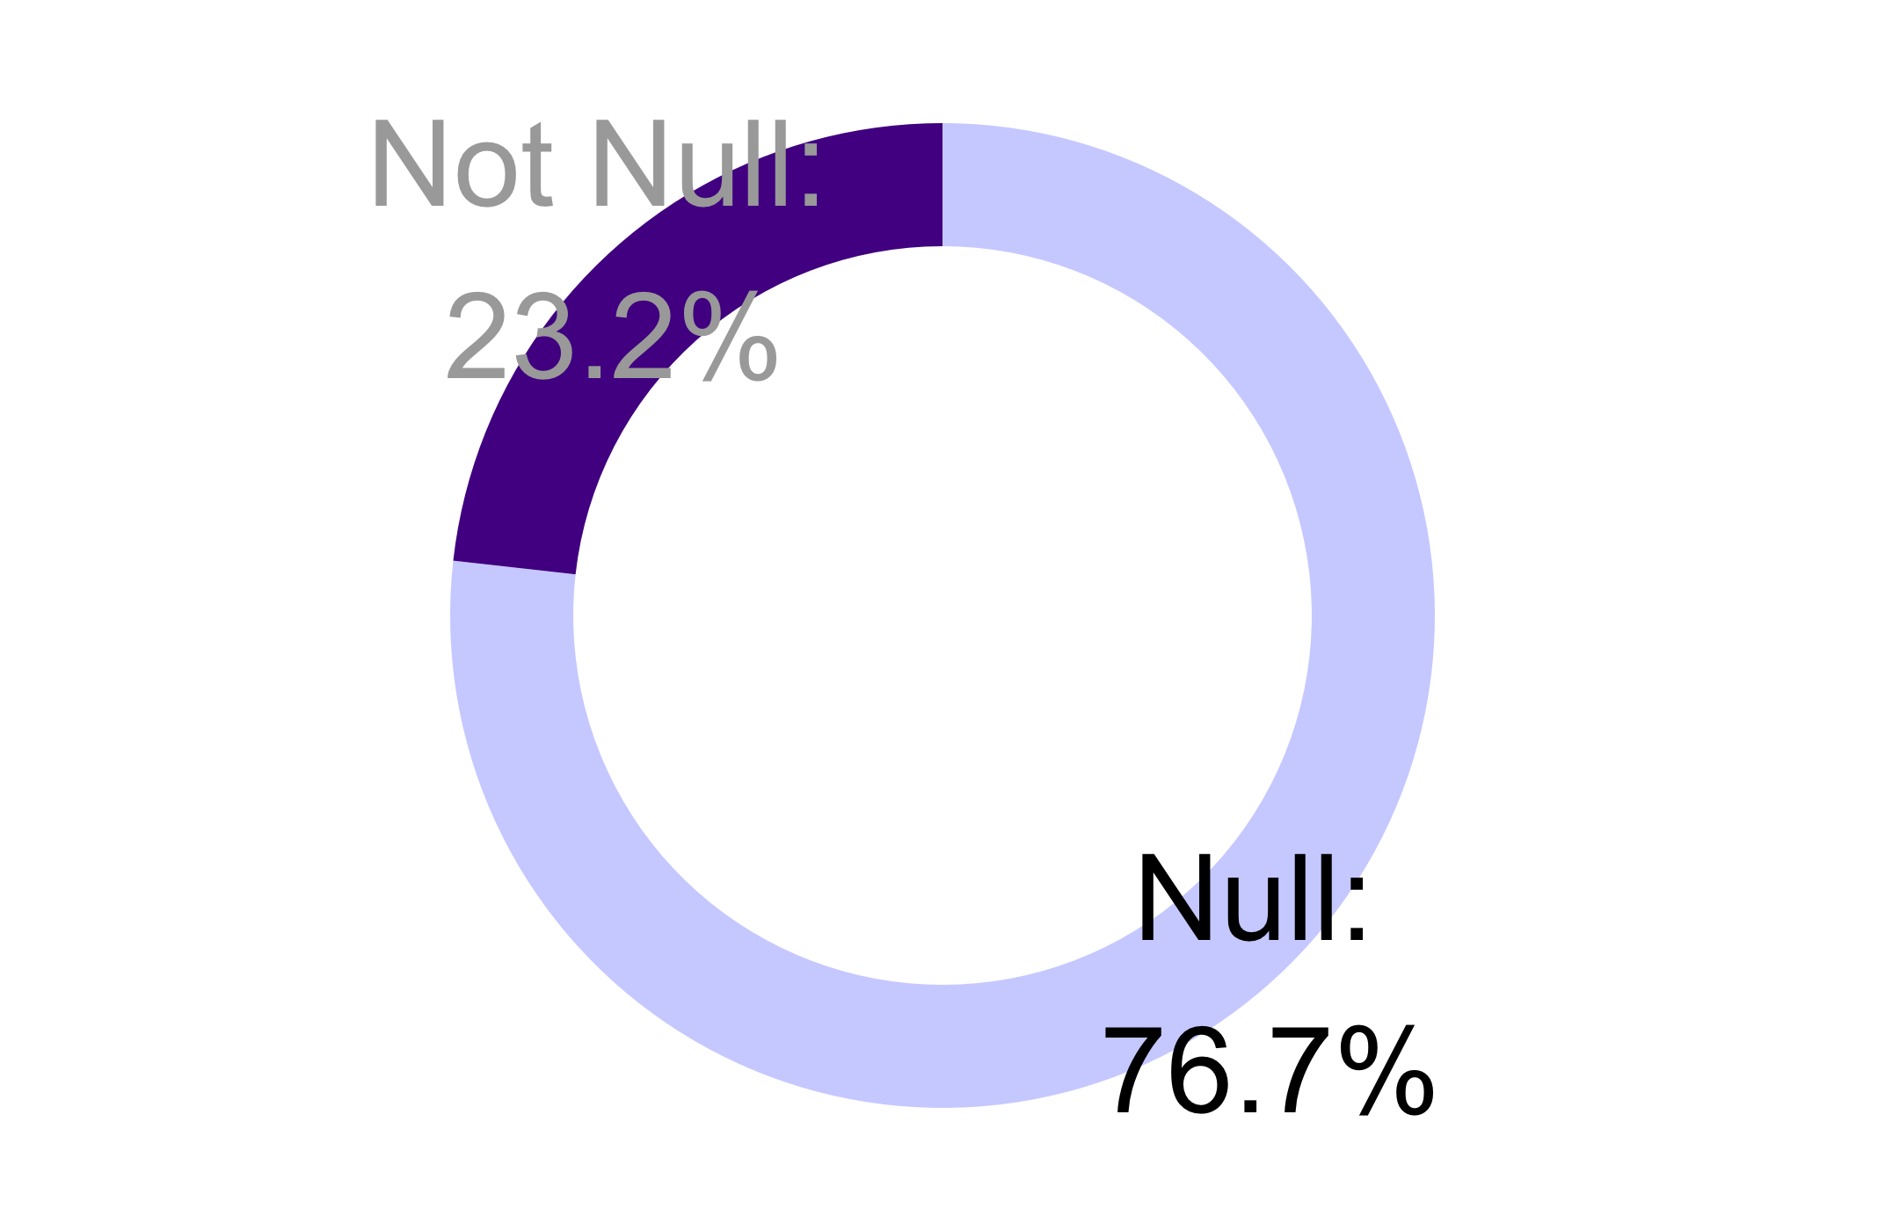
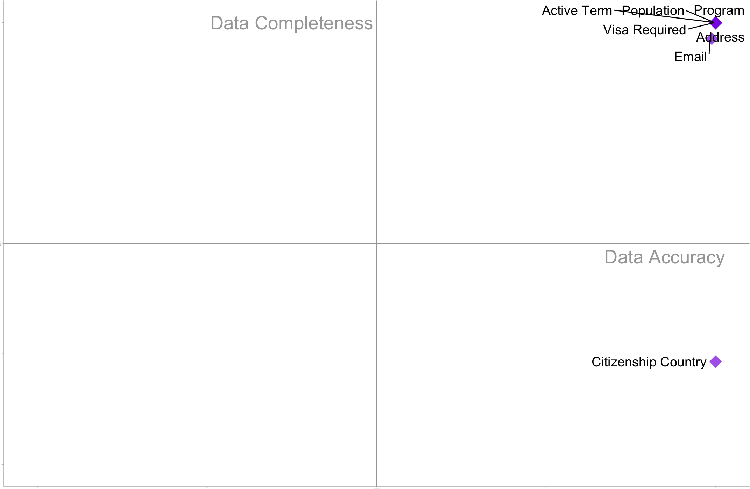
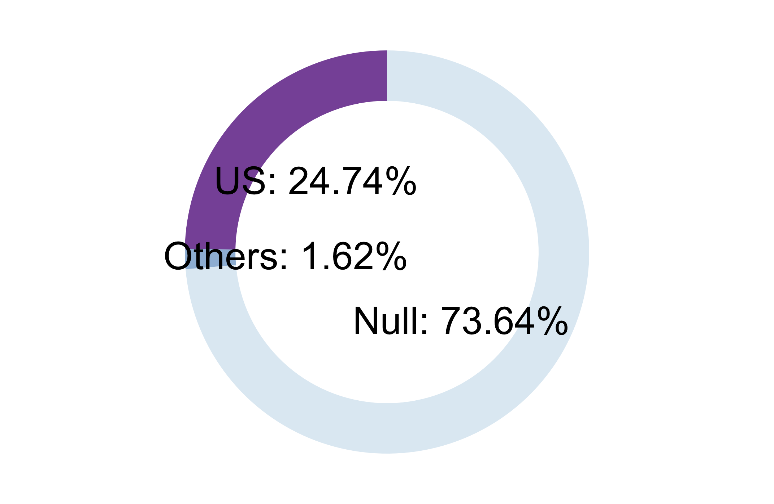
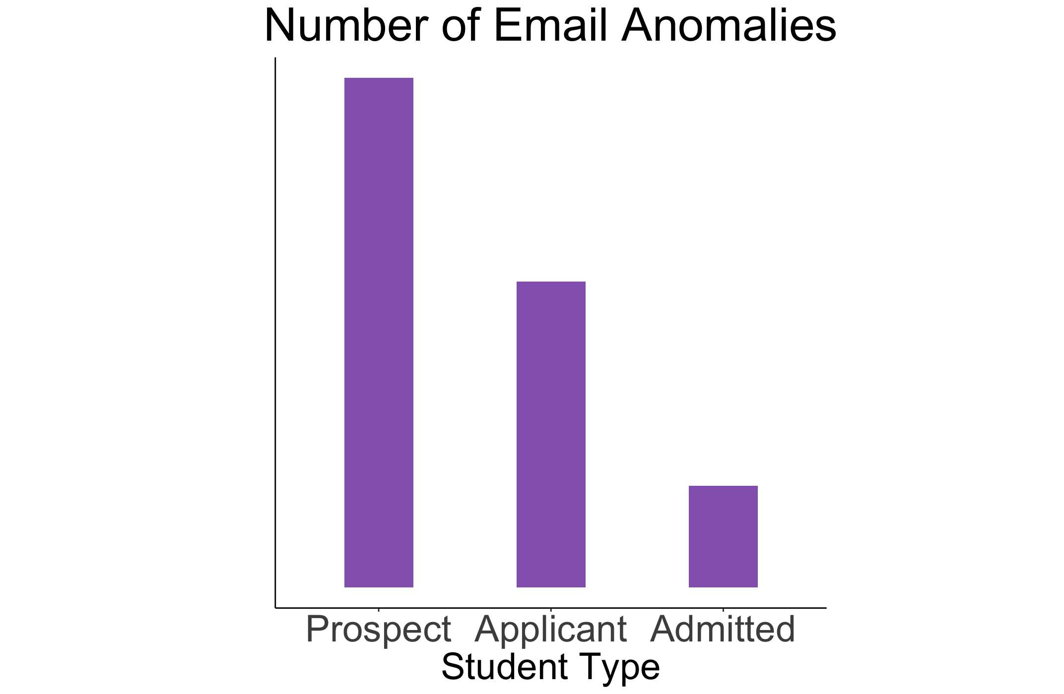
Data Quality of Admitted Student
Data Completeness
Citizenship Country:
Data Completeness vs Data Accuracy
2
1
Citizenship Status for null Citizenship Country
Data
Accuracy
3
4
Admitted students have highest data accuracy.

Slide 9
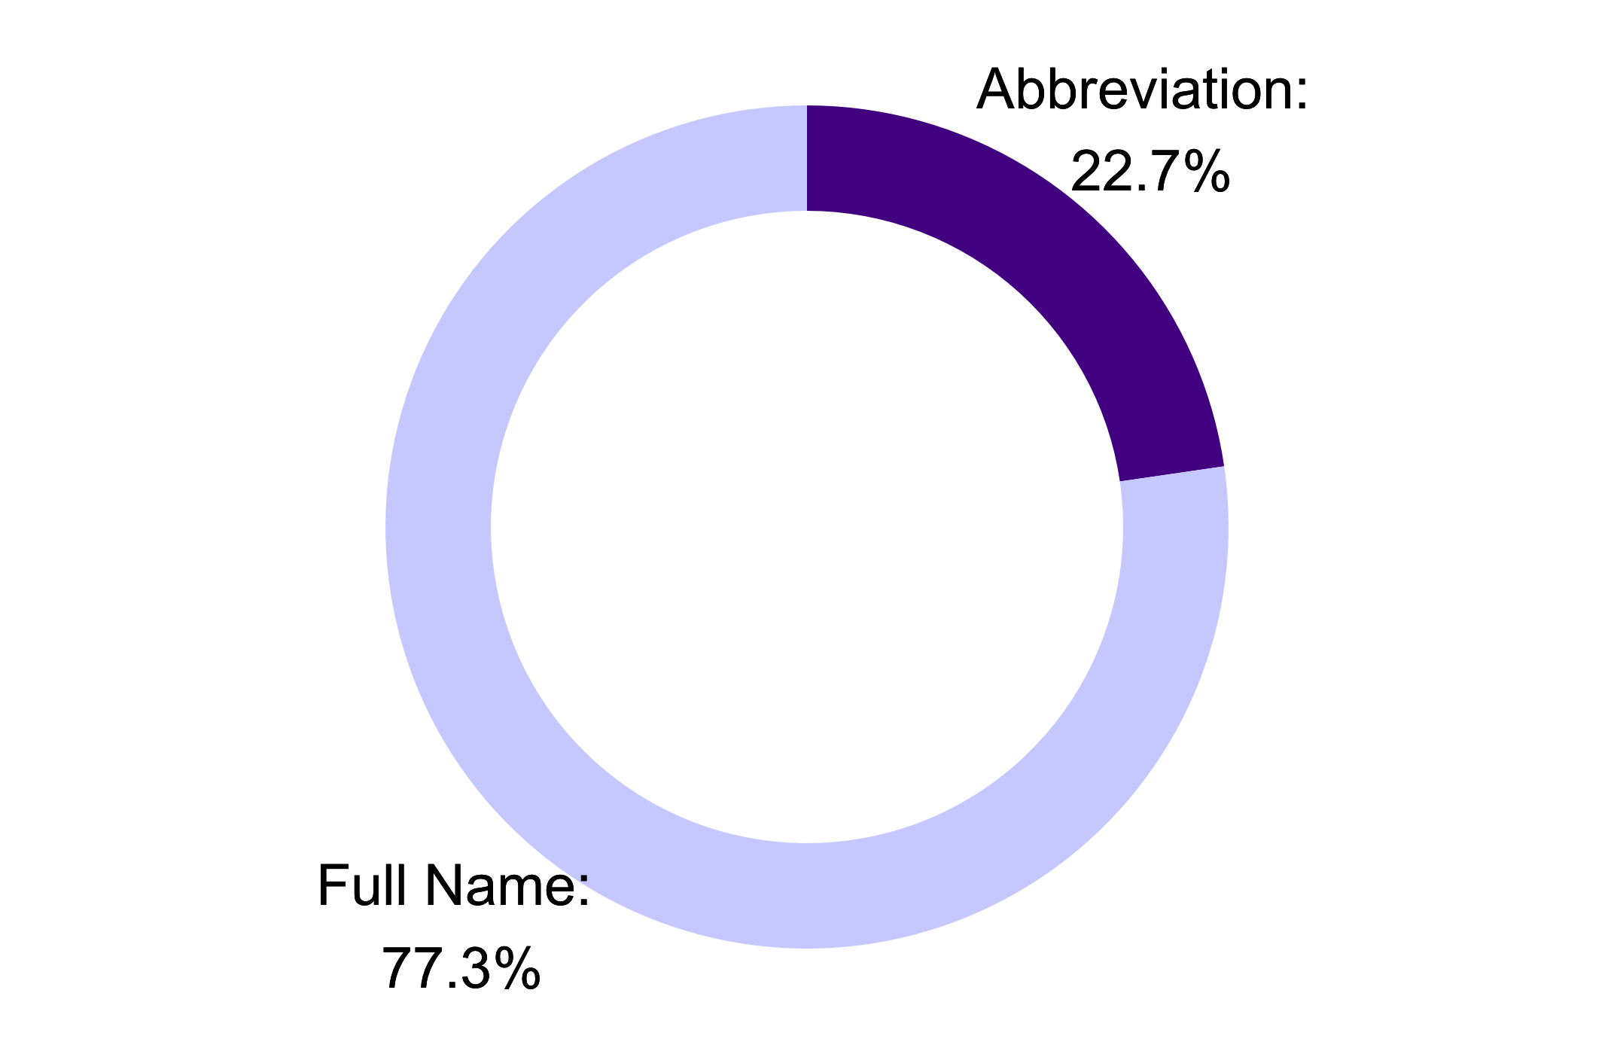
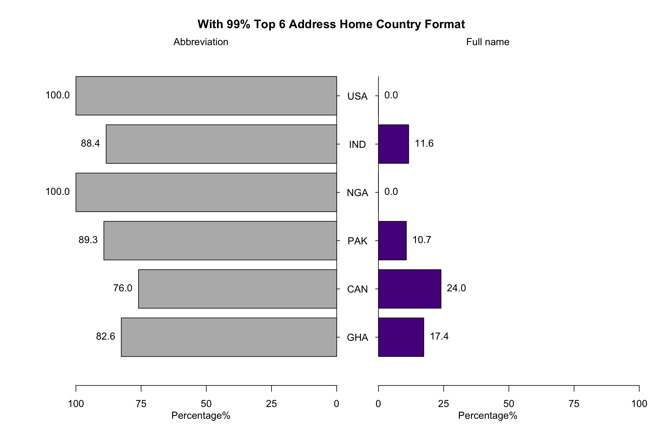
Data Consistency of Categorical Variables
There is no standard format for some categorical variable in the data
Country
Program
Example:
SCPSY <-> School Psychology
LL <-> Leadership and Learning
Marketing <-> Marketing (Online)

Slide 10



Recommendation for Data Cleaning
Country/Program
Make a table as a dictionary to transfer the
abbreviation to Full name
Clean the data with effective information
Email
Transfer unusual email suffix to common email suffix (.edu, .com, .org)
GPA
Clean the characters within the GPA column and analyze by considering middle 95% of GPA

Slide 11
Recommendation for Data Collection
Country/Program
Use the drop-down list to select Country or Program
Email
Send an email verification and only record those verified email
GPA
Provide the GPA with full score criteria
Let third-party institution to normalize GPA (WES)

Slide 12
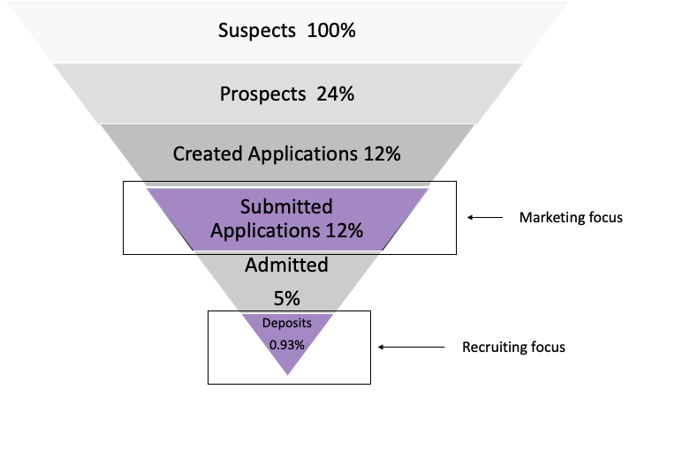
What is the best way to market / recruit students with incomplete data?
Marketing goal:
To maximize Submitted Applications
Recruiting goal: Recruit the best candidates
from the applications received

Slide 13
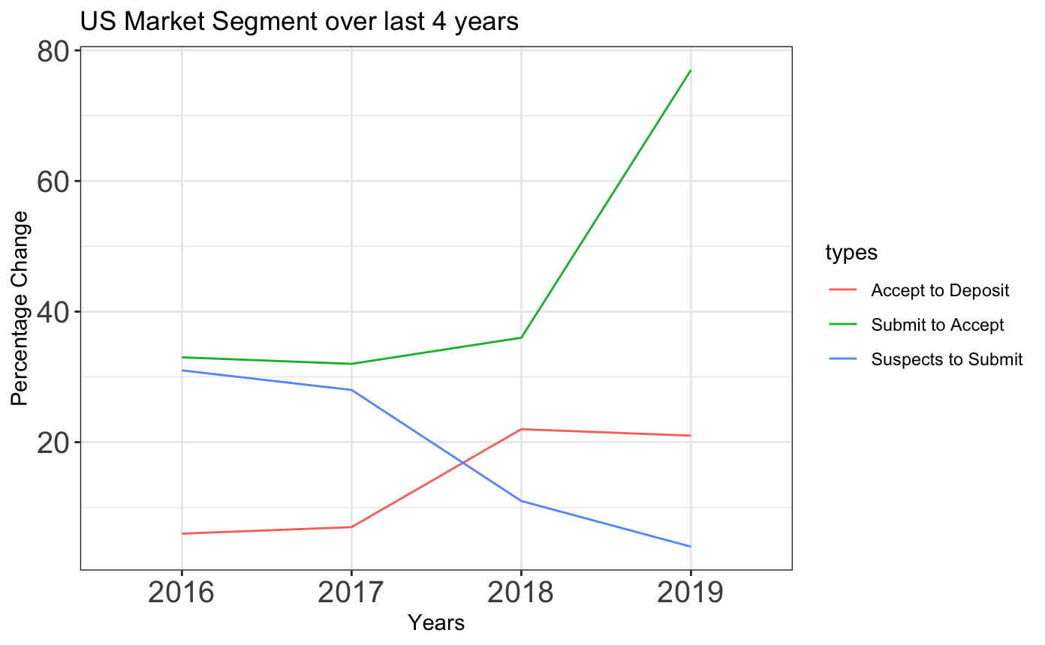
Marketing
Recruiting
Suspects
App Created
Submitted
Acceptance
Deposit
Steps:
Suspects to Submit
Submit to Accept
Suspects to Submit
Influencing factors:
Marketing Customized Marketing
User Engagement & follow up Median income Inquiries & Queries
Website Brand Name
Intended Program
CRM/Chatbots/Website
Notes:
From the milestone graph of the previous four years, it is clear that our acceptance rate has been significantly increased and we are also doing fair with recruiting ( acceptance to deposit), however emphasis should be given on this factor. Moreover, the most important thing is

Slide 14
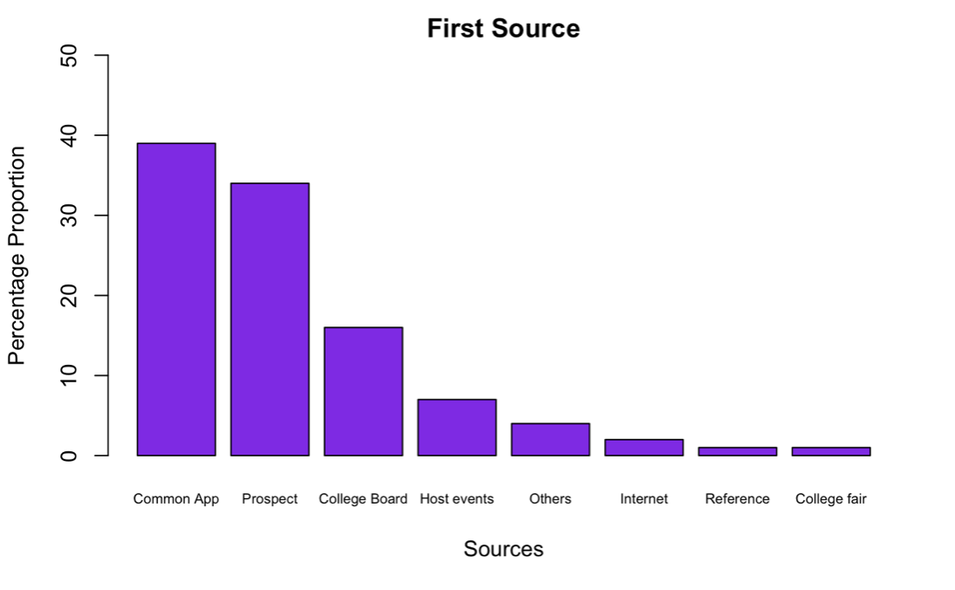
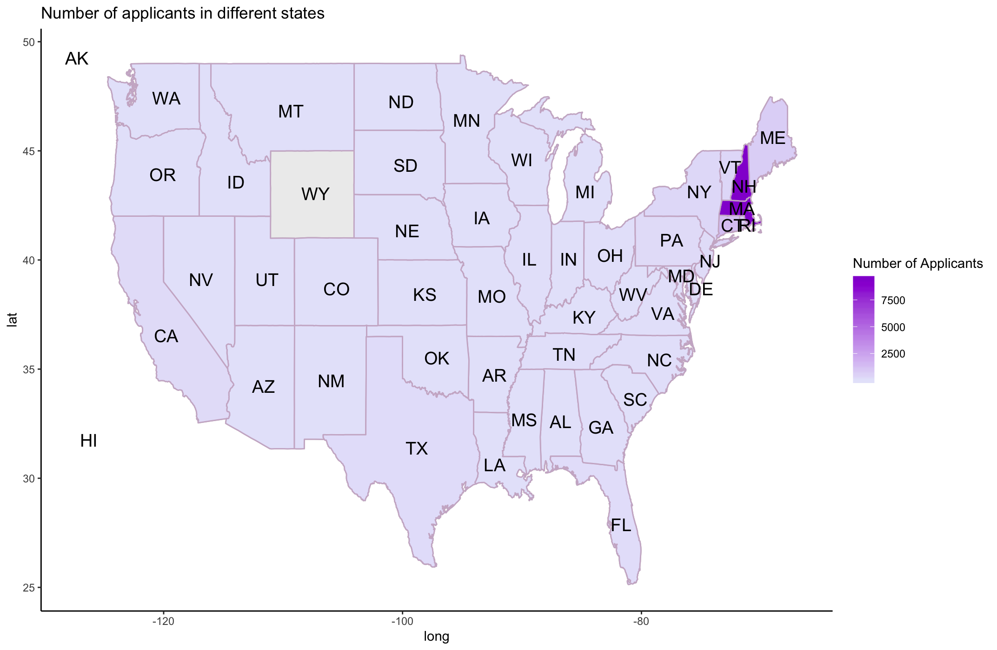

Segment: US Students
70% Applicants from top 10% Cities
95 % Applicants from Top 10% States
MA
NH
CT
RI
ME

Slide 15
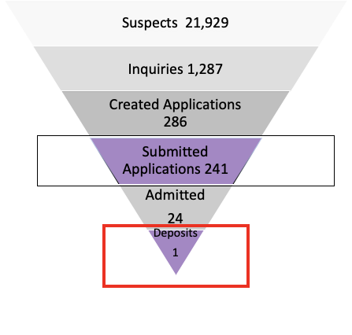
Recruit
Score based model can be explored
Based on GPA, experience, previous background, intended major user-engagement, interest, profile, CRM to optimize selection and retain.
Segment: International Students
Student yield-rate of international students is nearly 0%.
Need for change in marketing strategy for this segment.
Other countries with higher growth factor can be targeted.
Changes in growth trend/policies

Slide 16
Thank You
Any Questions?

